Slide 1
SUPER SCROLLING SHOOTER
(SSS)
HAO, YUZE
HARRISON, ADRIAN
NUNEZ, MIGUELANGEL
RAZZAK, IMTIAZ

Slide 2
INTRODUCTION
SSS is a browser based game that uses the Impact game engine.
The Impact engine is written in JavaScript to interact with the Canvas in HTML 5.
SSS is an exciting addition to the lineage of arcade shooters

Slide 3
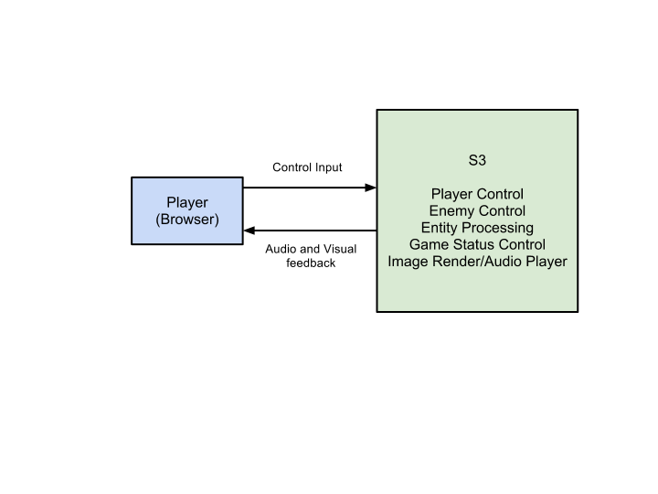
LEVEL 0 DFD

Slide 4
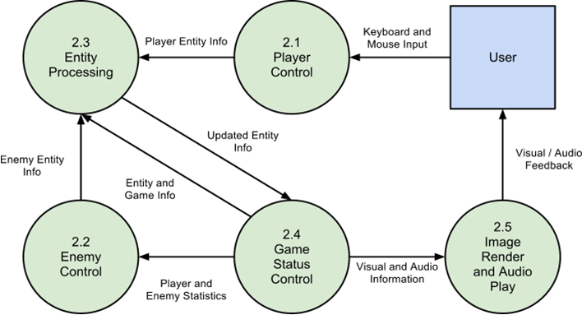
LEVEL 1 DFD

Slide 5
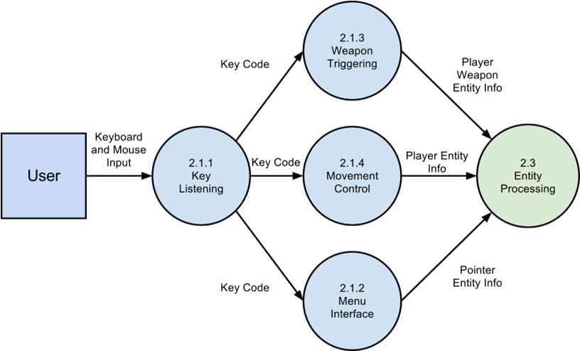
PLAYER CONTROL LEVEL 2 DFD

Slide 6
PLAYER CONTROL TEST MATRIX
 | 2.1.1 - Key Listening:
6.1-1 | SSS shall allow the user to move the player entity with a standard QWERTY keyboard. | Basis Path Testing
6.1-2 | SSS shall allow the user perform attacks with a standard QWERTY keyboard. | Basis Path Testing
 | SSS shall allow the user to switch weapon types with a standard QWERTY keyboard. | Basis Path Testing
6.1-3 | SSS shall allow the user to interact with menu in the game. | Condition Testing

Slide 7
PLAYER CONTROL TEST MATRIX
 | 2.1.2 - Menu Interface:
6.1-4 | SSS shall allow player to start the game by keyboard input. | Basis Path Testing
6.1-5 | SSS shall allow player to pause game by keyboard input. | Basis Path Testing
6.1-6 | SSS shall allow player to unpause(continue) game by keyboard input if in paused menu. | Basis Path Testing
6.1-7 | SSS shall allow player to restart game by mouse click if in paused menu. | Basis Path Testing
6.1-8 | SSS shall allow player to return to main menu by mouse click if in paused menu. | Basis Path Testing

Slide 8
PLAYER CONTROL TEST MATRIX
 | 2.1.3 - Weapon Triggering:
6.1-9 | SSS shall initialize player weapon entity data. | Condition Testing
 | 2.1.4 - Movement Control:
6.1-10 | SSS shall assign velocity of player entity. | Condition Testing

Slide 9
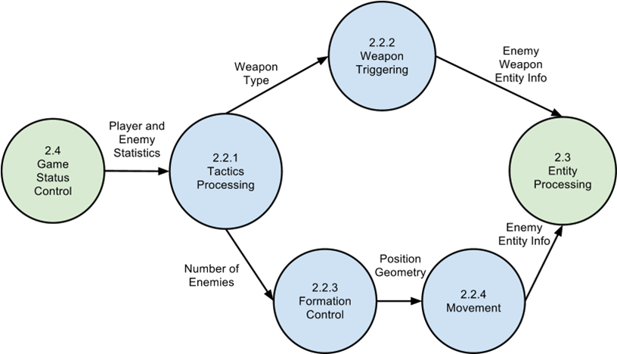
ENEMY CONTROL LEVEL 2 DFD

Slide 10
ENEMY CONTROL TEST MATRIX
 | 2.2.1 - Tactics Processing:
6.2-1 | SSS shall choose the formation of an enemy type. | Condition Testing
6.2-2 | SSS shall increase frequency of enemies based on score checkpoints. | Condition Testing
6.2-3 | SSS shall choose the spawn location of enemy formations based on movement statistics. | Orthogonal Array Testing
 | SSS shall choose from predefined enemy attack types. | Basis Path Testing
6.2-4 | SSS shall choose from predefined formations. | Basis Path Testing

Slide 11
ENEMY CONTROL TEST MATRIX
 | 2.2.2 - Weapon Triggering:
6.2-6 | SSS shall initialize enemy weapon entity data. | Condition Testing
 | 2.2.3 - Formation Control:
6.2-7 | SSS shall generate formations of enemies. | Condition Testing
6.2-8 | SSS shall change the frequency of formations. | Condition Testing
 | 2.2.4 - Movement:
6.2-9 | SSS shall generate a random path for enemy entity. | Orthogonal Array Testing
6.2-10 | SSS shall define a path entirely contained by the game boundary. | Orthogonal Array Testing

Slide 12
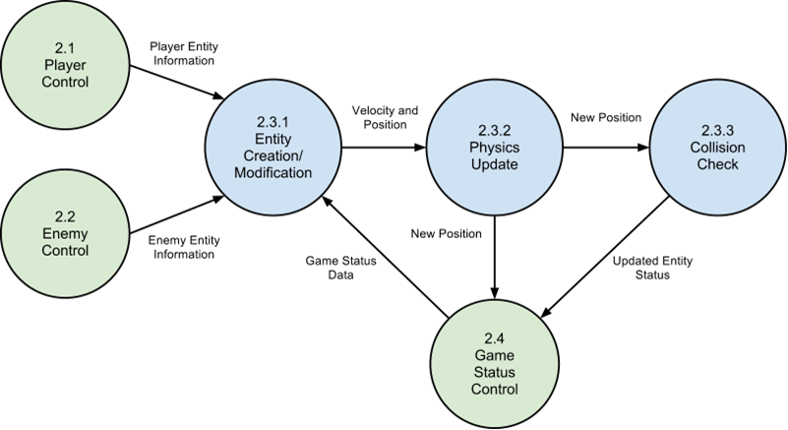
ENTITY PROCESSING LEVEL 2 DFD

Slide 13
ENTITY PROCESSING TEST MATRIX
 | 2.3.1 - Entity Creation/Modification:
6.3-12 | SSS shall create all entities. | Condition Testing
6.3-13 | SSS shall destroy defeated entities. | Condition Testing
6.3-14 | SSS shall destroy off-screen entities. | Condition Testing
6.3-19 | SSS shall update entities’ animation frames based on time since last animation frame change. | Basis Path Testing

Slide 14
ENTITY PROCESSING TEST MATRIX
 | 2.3.2 - Physics processing
6.3-15 | SSS shall calculate every entity’s physics attributes. | Orthogonal Array Testing
6.3-16 | SSS shall update the physics variable of every entity. | Orthogonal Array Testing
 | 2.3.3 - Collision Check
6.3-17 | SSS shall determine if entities have collided with each other. | Basis Path Testing
6.3-18 | SSS shall process the appropriate reactions of entity collisions based on predefined definitions. | Condition Testing

Slide 15
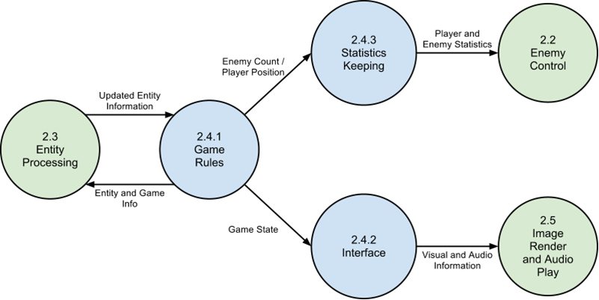
GAME STATUS CONTROL LEVEL 2 DFD

Slide 16
GAME STATUS CONTROL TEST MATRIX
 | 2.4.1 - Game Rules | Method Name
6.4-1 | SSS shall store predefined victory/failure conditions. | Condition Testing
6.4-2 | SSS shall end the game when victory/failure conditions have been met. | Condition Testing
6.4-3 | SSS shall meet failure conditions when the player uses up all available lives. | Condition Testing
6.4-4 | SSS shall meet victory conditions when the player defeats a final enemy. | Condition Testing
6.4-5 | SSS shall maintain a timer for the game. | Loop Testing

Slide 17
GAME STATUS CONTROL TEST MATRIX
 | 2.4.2 - Interface
6.4-6 | SSS shall change the interface when the game is started. | Condition Testing
6.4-7 | SSS shall change the interface when the game is paused or unpaused. | Condition Testing
 | SSS shall change the stage and reset conditions when victory is achieved. | Condition Testing
 | 2.4.3 - Statistics Keeping
6.4-8 | SSS shall count enemies that survive. | Loop Testing
6.4-9 | SSS shall decrement the player’s available lives when the player is destroyed. | Condition testing
6.4-10 | SSS shall keep track of player position over time. | Loop Testing

Slide 18
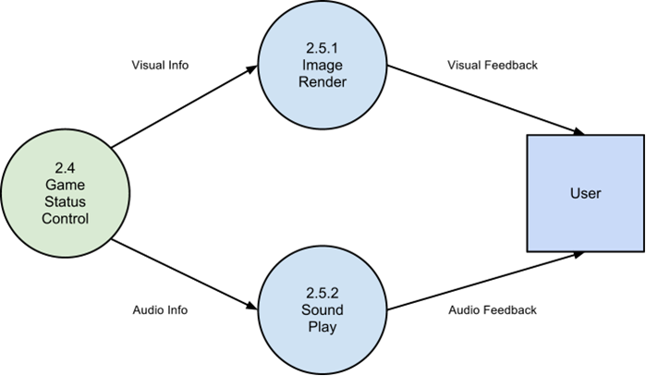
IMAGE RENDER AND AUDIO PLAY LEVEL 2 DFD

Slide 19
IMAGE RENDER AND AUDIO PLAY
TEST MATRIX
 | 2.5 - Image Render and Audio Player:
6.5-1 | SSS shall process image files to HTML5 canvas format. | Loop Testing
6.5-2 | SSS shall display images on the the HTML5 canvas. | Demonstration
6.5-3 | SSS shall play predefined audio data when predefined conditions are met. | Demonstration

Slide 20
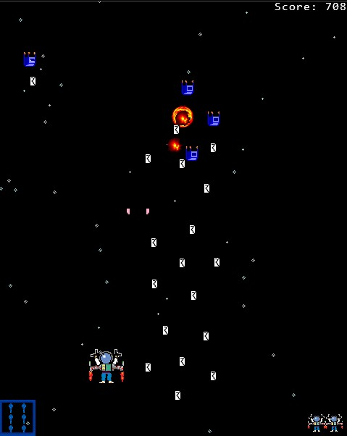
The Game
start: function(){
for( var i = 0; i < this.entities.length; i++ ){
this.entities[i].kill();
}
this.menu = false;
this.weaponType = 0;
this.lives = 3;
this.score = 0;
this.pointer = this.spawnEntity(Pointer, 0, 0);
random = (Math.random()*1.8 + .25);
this.starTimer = new ig.Timer(random);
this.formTimer = new ig.Timer(8);
this.player = this.spawnEntity(EntityPlayer, ig.system.width/2 - 24, ig.system.height * (4/5));
this.form = new ig.Formation();
ig.main.unpause(this);
}
});

Slide 21
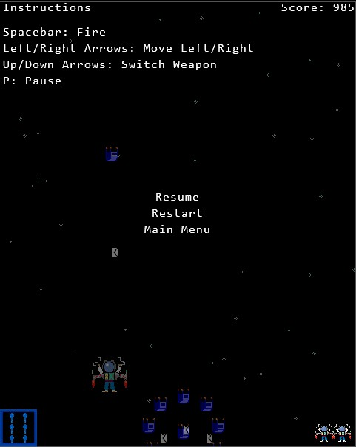
Pausing
ig.main.pauseNow = function(game){
game.pause = true;
ig.system.clock.pause = true;
game.formTimer.pause = true;
ig.system.pause = true;
var wMid = ig.system.width/2;
var hMid = ig.system.height/2 - 22*2;
var settings;
for(var l = 0; l < 3; l++){
var height = hMid + l * 22;
settings = {option: l, ref: {x:wMid, y: height }};
game.menus.push(game.spawnEntity(Menu, 0, height, settings));
}
for(var i=0; i < game.entities.length; i++){
ent = game.entities[i];
ent.pause=true;
if(ent.currentAnim != null){
ent.currentAnim.timer.pause = true;
ent.currentAnim.alpha = 0.45;
}
}
};

Slide 22
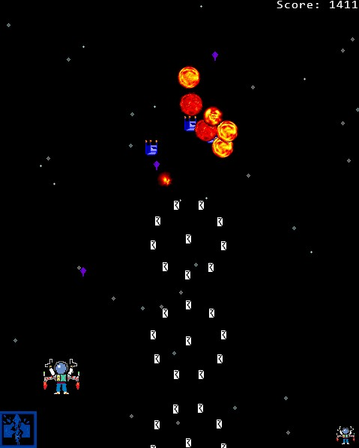
Formations
ig.Formation = ig.Class.extend({
formTimer: null,
enemies: 0,
enemyArr: null,
dummy: null,
form: 1,
delta: 0,
pi: 3.14,
totalEnemyArr: [],
pause: false,
stats: [],
init: function(){
this.enemies = 0;
this.enemyArr = [];
this.stats[3] = 100;
this.stats[1] = 100;
this.stats[2] = 100;
},

Slide 23

Heads Up Display
showHUD: function(notInMenu){
if(notInMenu){
var y;
var x = ig.system.width - 30;
for(var i = this.lives; i > 0; i--){
y = ig.system.height - 30;
this.liveStock.draw(x, y);
x -= 24;
}
}
this.hud.draw(0, ig.system.height*(11/12));
switch(ig.game.weaponType){
case 0:
this.nShot.draw(0, ig.system.height * (11/12));
break;
case 1:
this.sShot.draw(0, ig.system.height * (11/12));
break;
case 2:
this.aShot.draw(0, ig.system.height * (11/12));
break;
}
}
},

